Slide 1




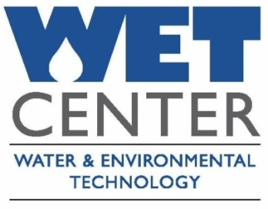
Survey of Public Perceptions Regarding Water Reuse in AZ:
Challenges and Opportunities
Channah Rock, PhD
Water Quality Specialist/Assistant Professor
Dept. of Soil, Water, and Environmental Science
University of Arizona

Slide 2
Challenges for optimization of water Reuse
The Triple Bottom Line
Economics – life cycle costs
Environmental aspects – energy consumption
the “carbon footprint”, water quality, and environmental protection
Societal views – public perception

Slide 3
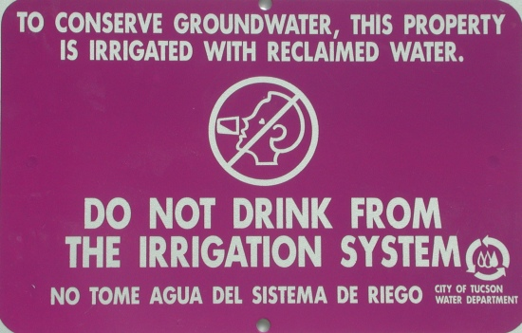
Reclaimed Water Quality Concerns
Safety of reclaimed water
  Quality regulated by USEPA and ADEQ
  Different water quality classes of reclaimed water (C, B, B+, A, A+)
Safety of infrastructure
  Identified by the color purple
  Dye tests to ensure there is no
  cross-connection between potable and
  reclaimed systems
Public Perception
  ‘Yuck’ Factor
  Education is key
  Prevent Toilet to Tap headlines
Is it clean enough?
  Pharmaceuticals, personal care products, EDC’s, microorganisms etc.
  Questions remain about accidental ingestion posing health concern for humans

Slide 4
How do we combat these concerns?
Waste Water Treatment Facilities treat water to extremely high standards
The majority of Recycled water produced in Arizona is considered A+ grade quality
Regulation and Permitting
Education

Slide 5
Statement of Need
Currently, there is a critical need to assess effluent generation and reuse in Arizona, both statewide and on a regional basis as well as public perception regarding this vital resource.
Identify public and industry perceptions regarding wastewater reuse and how these may affect current and future utilization of the resource

Slide 6

The Social Research Laboratory at Northern Arizona University surveyed 400 randomly-selected Arizona adults by telephone between September 27 and October 2, 2008.
Survey results are subject to a margin of error of +/- 4.9 percent.

Slide 7
Statewide Public Perception Survey
Perception of Terms
Support for Potential Uses of Reclaimed Water
Concerns about Using Reclaimed Water
Support of Implementation Strategies
“What would reduce your concerns about reclaimed water?”

Slide 8
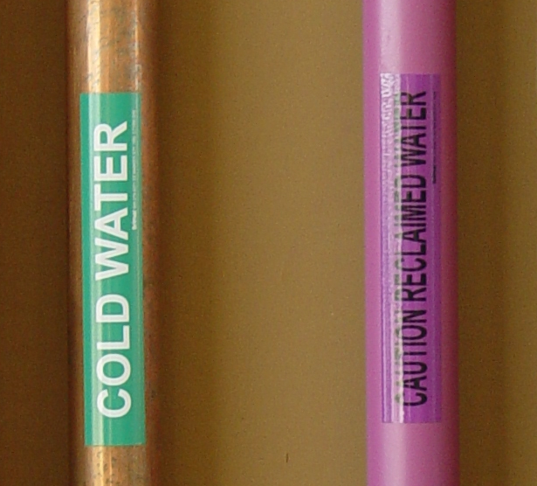
Terminology
Positive
  “water re-use”
  “recycled water”
  “re-purified water”
  “reclaimed water”
Negative
  “effluent”
  “tertiary treated wastewater”
  “wastewater”
  “toilet to tap”

Slide 10
Potential Use
Arizona residents generally support most potential uses of reclaimed water.
  for cooling towers in power plants
  fire hydrants for fire fighting
  to control dust on roads and at construction sites
  for watering the grass at cemeteries
  for watering the grass at golf courses
  for watering non-edible crops, such as cotton
  for toilet flushing in public or commercial buildings
  to sustain cottonwood trees and other plants along rivers

Slide 11
Potential Use cont…
  for watering household yards
  for watering public parks and schoolyards
  for watering orchards
  to restore habitat for wildlife
  for watering livestock feed crops, such as hay or alfalfa
  for snowmaking at ski areas
  to increase stream flows to support recreational activities like fishing and camping
  to replenish groundwater supplies
  for watering vegetable crops

Slide 13
Implementation Strategies
76% of Arizonans support using “consumer incentives for using reclaimed water.”
Over two-thirds of Arizonans (67%) support “increasing water or sewer rates to treat water to higher standards.”

Slide 14
Support/Opposition for potential uses of reclaimed water treated to higher standards

Slide 15
Mandatory Use
Respondents are divided on “mandatory use of reclaimed water.”
  45% support mandatory use,
  45% percent oppose it, and
  the remaining 10% are unsure.

Slide 16
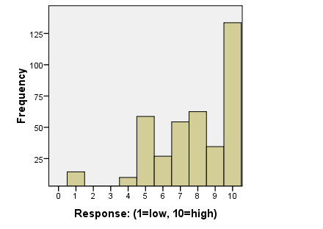
How important is it to you that your community uses reclaimed water to help meet its water needs?
1 means “not at all important” and 10 means “very important”
n = 400, Mean= 7.62, Std. Dev. = 2.357

Slide 17
“Other” Open-ended responses:

Slide 18
“Where do you receive most of your information about reclaimed water?”
An organization in Tucson about water
Area sanitation department
Global water
From this survey
ADWR, seminars
From the Arizona Nursery Association
From the Arizona Water Reclamation committee
From this survey
History of living of Arizona
I just got it from you
Information meeting from Arizona water in person
Labels on water bottles
Living with it when I was living in the outback in the desert
Prescott Valley has two towns that use reclaimed water
Telephone surveys
US EPA

Slide 19
“What else would reduce your concerns about reclaimed water?”
“The more that it is used the more comfortable I will be with it”
“Educate the people to use water in the best way.”
“I would like to take a tour of the treatment plant and see for myself and understand that it is safe”
“Knowing who is checking on the water”

Slide 20
“What else would reduce your concerns about reclaimed water?” cont.
“If there was some type of speaker that gave positive reasons to use it”
“Assurance that the whole system was secure and that water was treated properly”
“Information from a known source”

Slide 21
Concerns
Almost two-thirds of Arizonans have concerns about reclaimed water.
These concerns can be dispelled for respondents by providing
  “stronger oversight of treatment plants”
  “better wastewater treatment”
  “better information about reclaimed water”

Slide 22
How do we facilitate change and combat community concerns while encouraging positive responsiveness in society?

Slide 23
Tools to Implement Change
Decision-making agencies need to identify and address key factors in their communities that are likely to influence their support or otherwise, of the schemes.
  identify what is important to people in their decisions
  focus community engagement programs on the key areas to address.

Slide 24
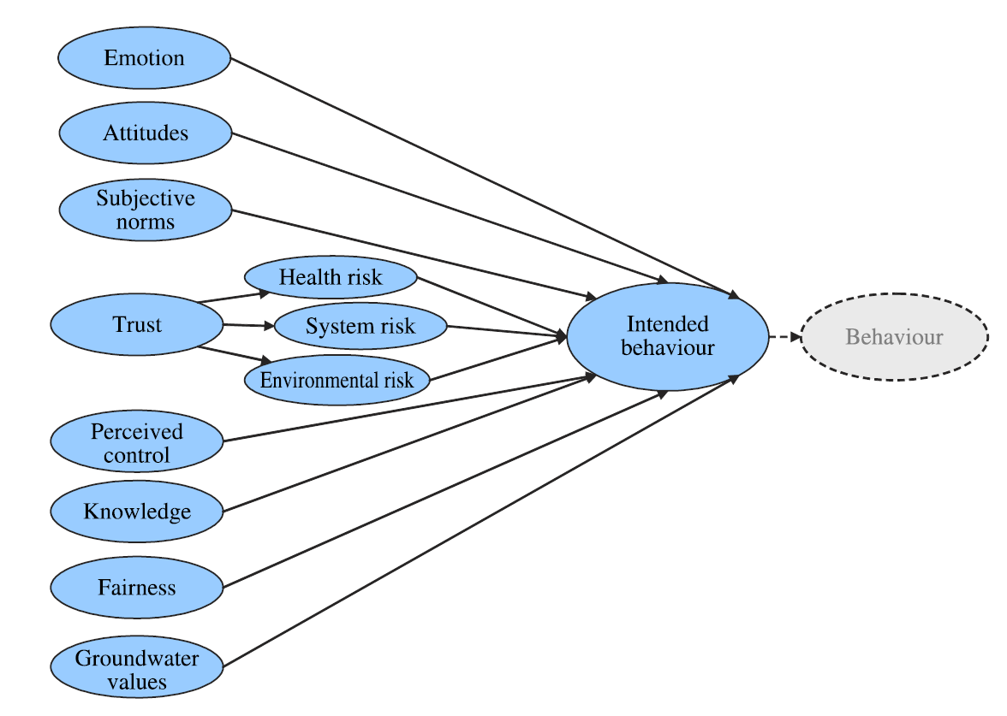
B. E. Nancarrow, Z. Leviston, M. Po, N. B. Porter and D. I. Tucker;
What drives communities’ decisions and behaviors in the reuse of wastewater; 2008, p.485 Water Science and Technology

Slide 25
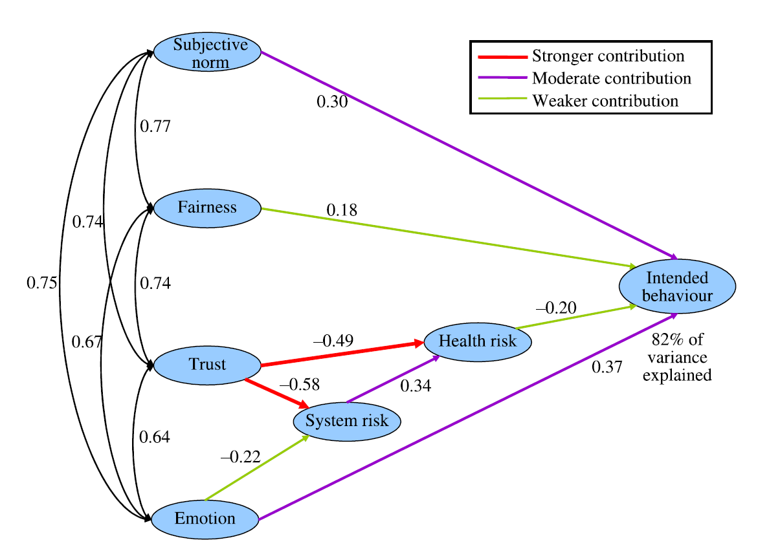

Slide 26
Risk and Trust
Factors such as risk perceptions or organizational trust are potentially more receptive to change.
High correlations between Risk and Trust suggest that if one is able to exert change in people’s risk and trust perceptions, one might also promote change in variables otherwise less receptive to change.

Slide 27
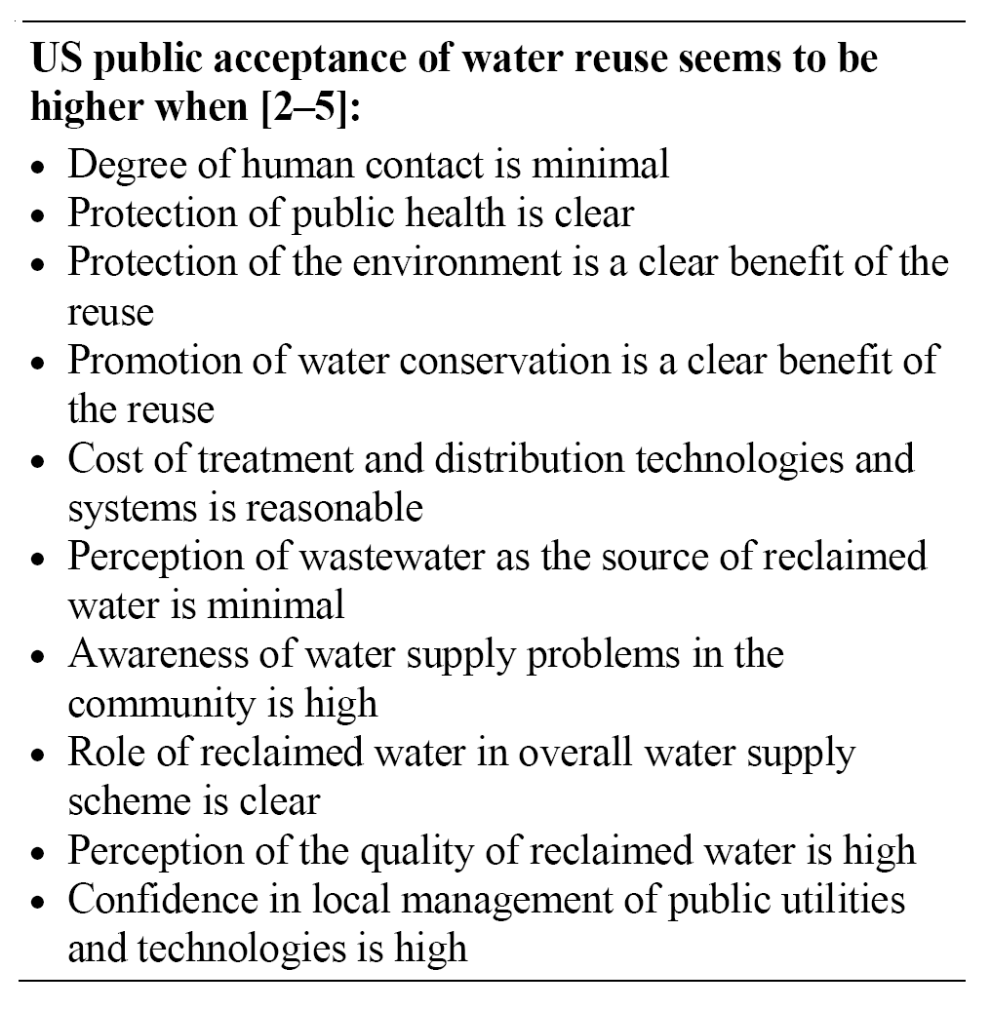
Troy W. Hartley; Public perception and participation in water reuse; Desalination 187 (2006) 115–126

Slide 28
Challenges for Reuse in Arizona
Planning and Infrastructure
Treatment Effectiveness
Public Perception
Quality Assurance

Slide 29
Principles for undertaking water resource planning initiatives:
Demonstrate organizational commitment
Promote communication and public dialog
Ensure fair and sound decision-making and decisions
Build and maintain trust

Slide 30
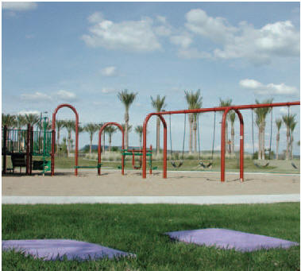
Future Vision for Successful Water Management
These principles aim to promote a more constructive public dialog on water reuse and contribute to the potential for building public trust and confidence.

Slide 31
Blue Ribbon Panel ON water Sustainability
The Purpose of the Blue Ribbon Panel on Water Sustainability is to…
“…advance water sustainability statewide by increasing reuse, recycling, and conservation to protect Arizona's water supplies and natural environment while supporting continued economic development and to do so in an effective, efficient and equitable manner.”

Slide 32
Working Groups
Public Perception/Acceptance
  The goal of this work group is to make recommendations for enhancing public acceptance of the use of reclaimed and recycled waters through public education, outreach, and other strategies.
Regulations and Permitting
  The goal of this work group is to identify regulatory impediments and make recommendations to streamline the reuse of reclaimed water.

Slide 33
Working Groups
Infrastructure/Retrofit
  The goal of this work group is to recommend measures that will facilitate the design, construction, operation and maintenance of new and retrofitted reclaimed and recycled water systems.
Conservation/Recycling/Efficiency/Energy Nexus
  The goal of this work group is to make recommendations regarding statutes, rules, policies, and strategies for increasing water conservation in the agricultural, industrial, and municipal sectors; increasing the recycling of water that is not considered reclaimed water; and reducing the water cost of energy and the energy cost of water.

Slide 34
Working Groups
Economic Funding
  The goal of this work group is to make recommendations on incentives, approaches to funding, and other mechanisms that will accelerate the reuse of reclaimed and recycled waters

Slide 35
Additional Arizona Efforts
Effluent Assessment
  Pima County
  Tucson Water
WateReuse AZ & AZ Water Reuse Committee
  Annual Arizona Reclaimed Water Workshops
    Flagstaff - November 3rd
    Glendale – November 23rd
    Tucson – December 8th
SNWA, Tucson Water, AMWUA, and many others!
Education and Outreach

Slide 36
Direct Potable Reuse
Direct potable reuse is the introduction of recycled water directly into a potable water distribution system. Criteria have yet to be developed or proposed for direct potable reuse in the U.S.
California Urban Water Agencies
National Water Research Institute
WateReuse Association California Section
Strategic plan

Slide 37
Direct Potable Reuse Issues
Public acceptance.
Communication between agencies in the water supply chain and between agencies and the public/customers.
Microbial and chemical constituents of concern.
Effectiveness and reliability of treatment unit processes.
Multiple barriers of protection.
Monitoring needs (treatment processes and product water).
Use of indicators/surrogates for both microbial and chemical constituents.
Redundancy in treatment.
Management and operational controls.
Permitting issues.

Slide 38
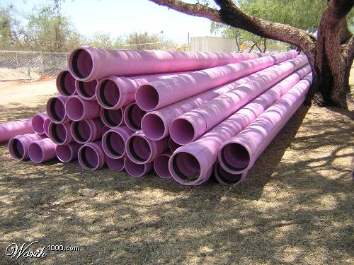
Acknowledgements
  Kristine Uhlman
  Susanna Eden
  Erin Westfall
  Shawn Newell
  Fred Solop
  Jelena Vukomanovic
  Terry Sprouse
  Meg White
  Juliet Stromberg
  Arizona Water Institute (AWI)
  ADEQ, ADWR, and participating utilities
  Water Sustainability Program (WSP)
  UA – Water Environment and Technology Center (WET)

