Slide 1
Teaching Sustainability with Flash Fiction
Climate Change
National Sustainability Teachers’ Academy

Slide 2
What is Flash Fiction?
Short stories (500 words or less)
Focus on imagery and emotion
Think about:
Setting
Characters
Plot
Backstory
Details
National Sustainability Teachers’ Academy

Slide 3
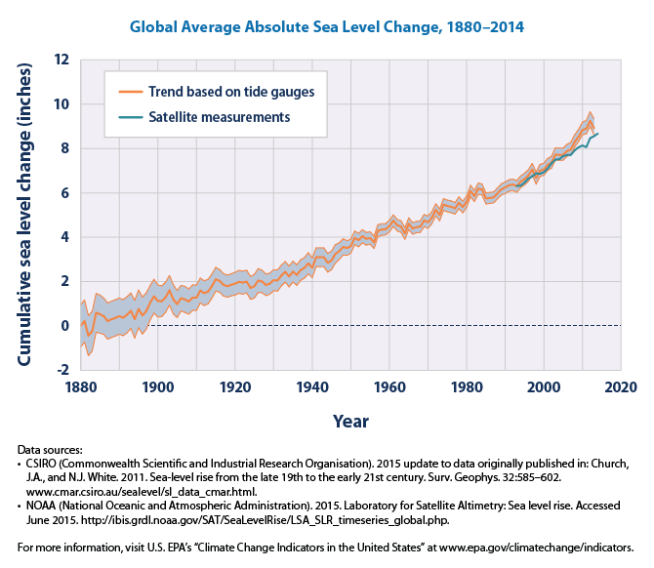
Sea Level Change
This figure shows how global average sea levels have changed since 1880

Slide 4
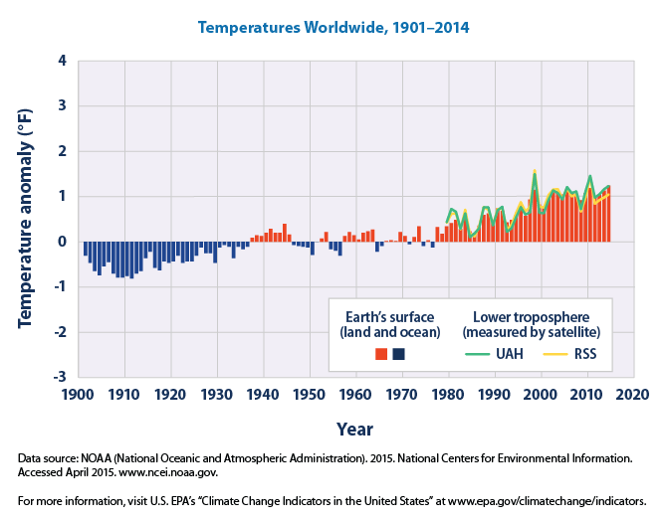
Temperatures
This figure shows how annual average temperatures worldwide have changed since 1901

Slide 5
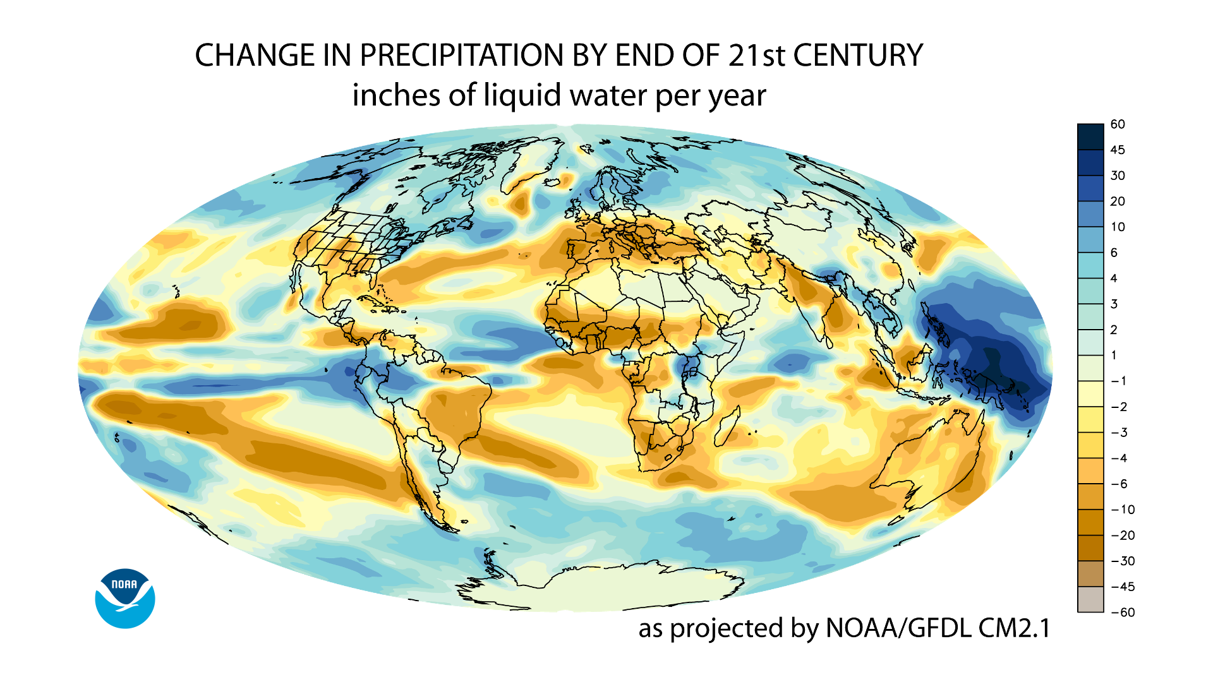
Precipitation
This graph shows how annual precipitation (in inches of water) are expected to change in the next 80 years

Slide 6
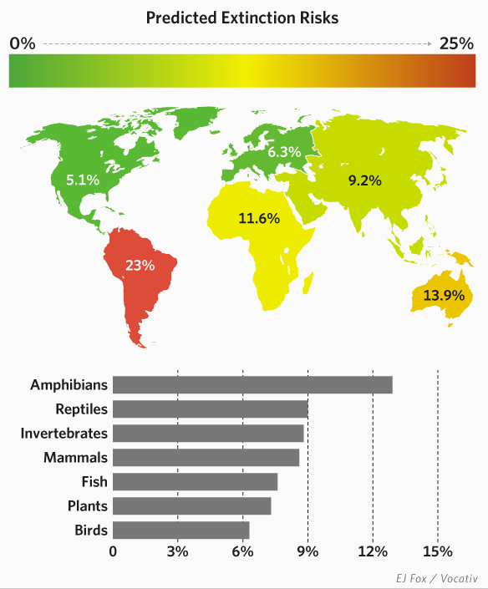
Extinctions
This figure shows regional percentages of animal species at risk of extinction due to climate change

Slide 7
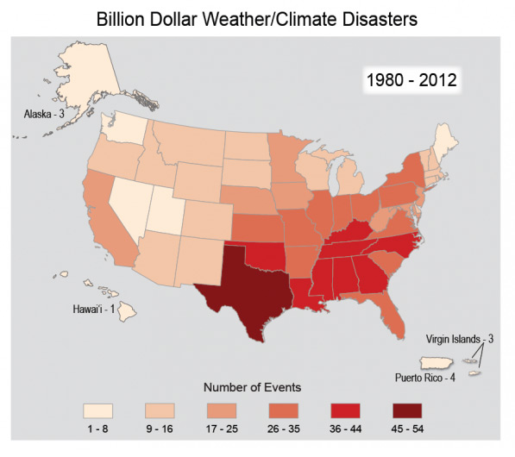
Extreme Weather
This figure shows the number of disasters related to weather or climate that cost $1 billion or more from 1980-2012

